Slide 1
Shared Ownership The Consumer Perspective
Sue Phillips (FCCA), Founder, Shared Ownership Resources
www.sharedownershipresources.org

Slide 2
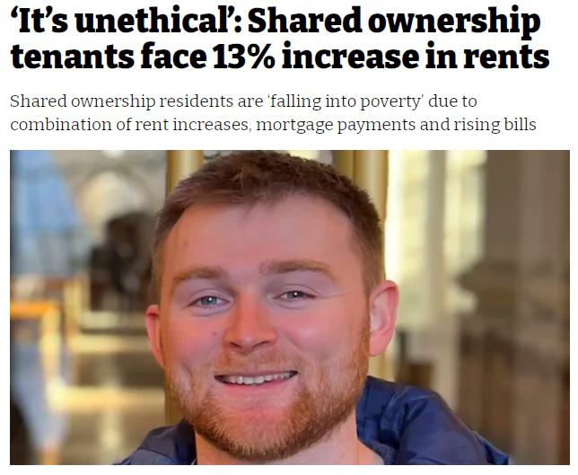
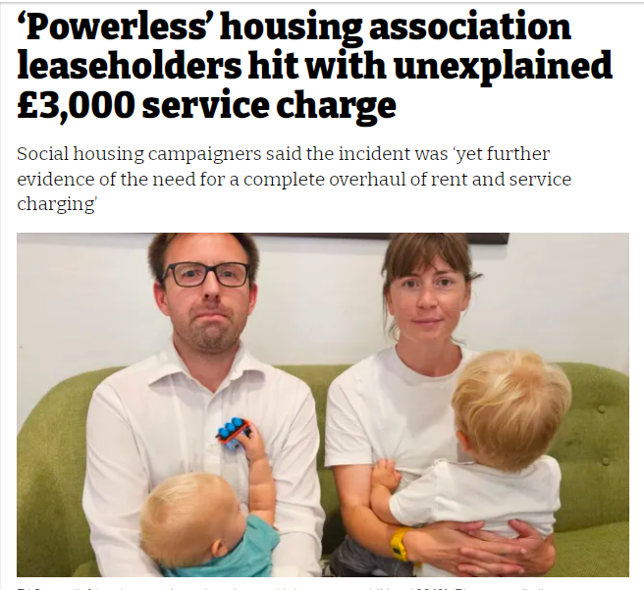
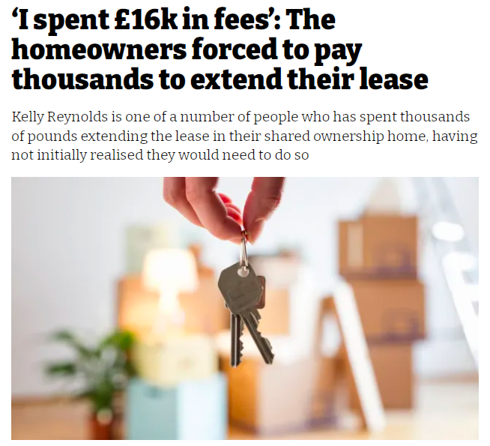
Media spotlight on SO

Slide 3
Regulator spotlight on SO

Slide 4
LUHC Committee spotlight on SO
The LUHC Committee’s terms of reference align closely with key themes of Shared Ownership: The Consumer Perspective.
Affordability and ongoing financial sustainability
Viability of full home ownership (pathway or destination?)
Value for money
Adequacy of monitoring data

Slide 5
Shared Ownership: The Consumer Perspective KEY MESSAGES
SHARED OWNERSHIP TODAY | Characterised by increasingly complex financial and corporate structures with implications for regulation and shared owner outcomes
AFFORDABILITY | Affordability, financial sustainability and VFM are not maintained over time.
PATHWAY TO FULL OWNERSHIP | Shared owners can end up trapped in a home that is increasingly unsuitable and unaffordable, with no viable exit route.
FAIRNESS AND SATISFACTION | Satisfaction is lower than other tenures and declines over time. Many aspects of the scheme are perceived as unfair.
CONSUMER PROTECTION | Shared owners are excluded from rights and protections available to other homebuyers.
NEW MODEL FOR SHARED OWNERSHIP and THE RIGHT TO SHARED OWNERSHIP | Fail to address the most pressing concerns, and expose more financially vulnerable households to risk.

Slide 6
What is the evidence that shared ownership delivers good outcomes?
“Statistics are like bikinis. What they reveal is suggestive, but what they conceal is vital”.
(Aaron Levenstein)
Gaps in national monitoring data
No analysis between 100% staircasing (success) and back-to-back sales (failure)
Little evidence for claimed outcomes
Via staircasing to 100%
Via gain on sale of ‘starter home
As a secure and affordable form of renting
Satisfaction is low compared to other tenures and decreases over time
Housemark (2021) - ‘The average percentage of shared owners satisfied with their landlord overall was just 57% last year, 26 percentage points lower than the equivalent figure for social rented tenancies.’
Complexity
Legal complexity
Financial complexity
Complexity of ownership and management structures
Consumer Protection
Shared owners have fewer protections and rights than other consumers
Misleading marketing
No single specialist, independent and impartial source of information

Slide 7
Shared Ownership: The Consumer Perspective
The report makes 18 recommendations for multi-agency reform. The primary focus is on:
Legislation
Regulation
Design and delivery
Marketing, and
Sources of information and advice
The report is aimed at decision makers in government, its agencies, regulators and housing providers.
www.sharedownershipresources.org/campaigning/reports/consumer-perspective/
info@sharedownershipresources.org

